Slide 1
Can KV-cache serve as compact memory module when reasoning over long or unbounded contexts?
Ziyang Huang, Yingfei Xu
Notes:
Hi everyone! My name is Ziyang Huang, and this is Yingfei Xu. Today we will discuss two papers attempting to answer this question: can KV cache serve as compact emory module when reasoning over long or unbounded contexts.

Slide 2
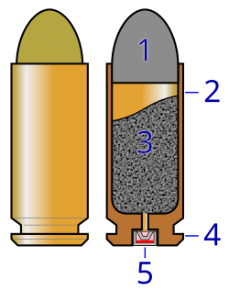
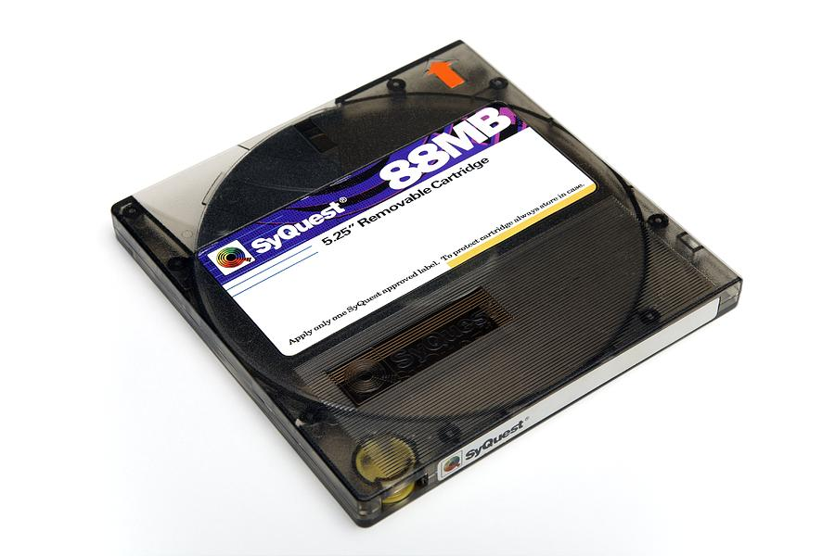
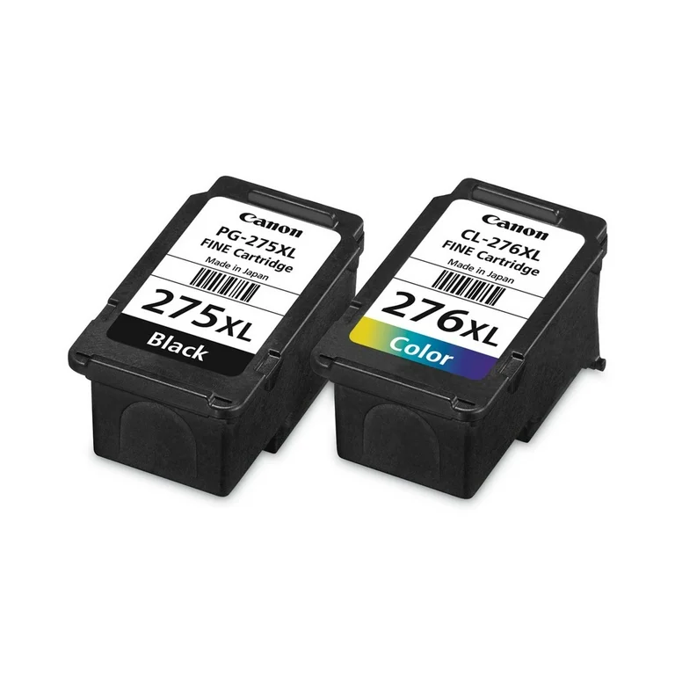
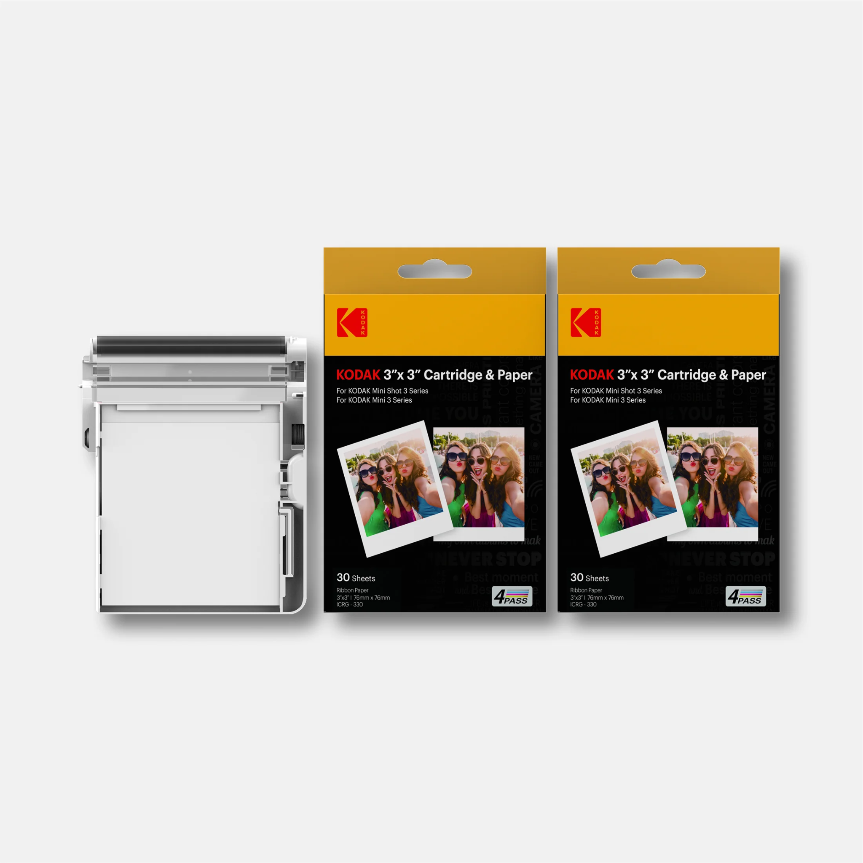
Cartridges: Lightweight and general-purpose long context representations via self-study
Sabri Eyuboglu, Ryan Saul Ehrlich, Simran Arora, Neel Guha, Dylan Zinsley, Emily Ruoyu Liu, Atri Rudra, James Y. Zou, Azalia Mirhoseini, Christopher Re
Notes:
The first paper is Cartridge, a light weight and general purpose long context representations learned via self-study.
For anyone who’s not familiar with the word Cartridges, they are some containers that can be easily swapped for another replacement. In this context, it is a memory module that can be “installed” into the LLM inference pipeline as a alternative to computed KV cache.

Slide 3
Long‑context ICL is accurate but expensive: KV ∝ input length.
But can we use a swappable KV cache module and reuse it?
Cartridges
Turning long corpora into tiny, reusable KV prefixes for fast, high‑quality answers.
Performance
ICL‑like quality with dramatically less memory and higher throughput when many queries target the same corpus.
Notes:
Here’s is the overview. The paper aims to solve a critical issue with long-context generation. We all know in context learning is powerful, but they are also expensive in that the memory required to store the KV cache of those context information grows as the length of context increases.
But what if we can build a swappable KV cache module and reuse it? The researchers proposed what’s called Cartridges, which turns long corpora into tiny, reusable KV prefixes for fast, high-quality answers. The performance is promising. Cartridge achieves ICL-like quality with dramatically less memory and higher throughput, when many queries target the same corpus.

Slide 4
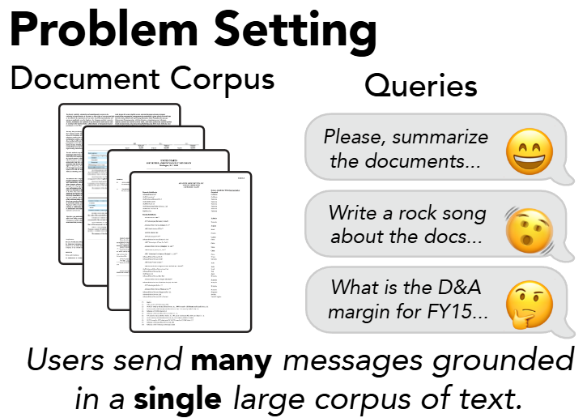
Motivation
Notes:
Let’s start with a common use case. Suppose you are a software developer for a large project. You are using some coding copilot, but the software is too new to be included in the pretraining data of the LLM. In this case, you might want to throw the entire documentation in to the context so the LLM can help you write some code or answer your question.
Obviously that will easily fill out the context length and computationally expensive. Because you need 50 gigs of VRAM to hold the context, and the throughput collapses as the context increases. And if your colleagues are doing something similar...

Slide 5
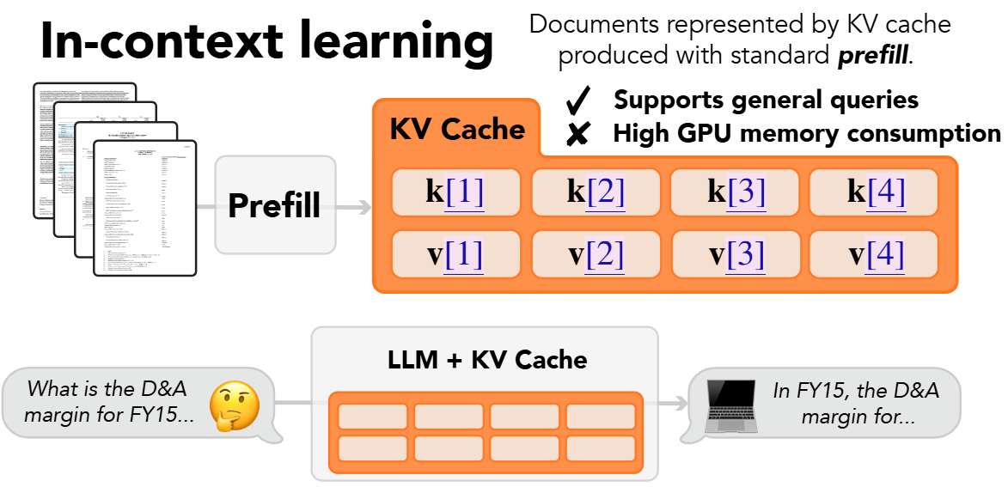
Motivation
Notes:
But wait, you might say we can do prefill for in-context learning. That’s true, but still that requires a lot of valuable GPU memory. Then how about we limit the size of it?

Slide 6
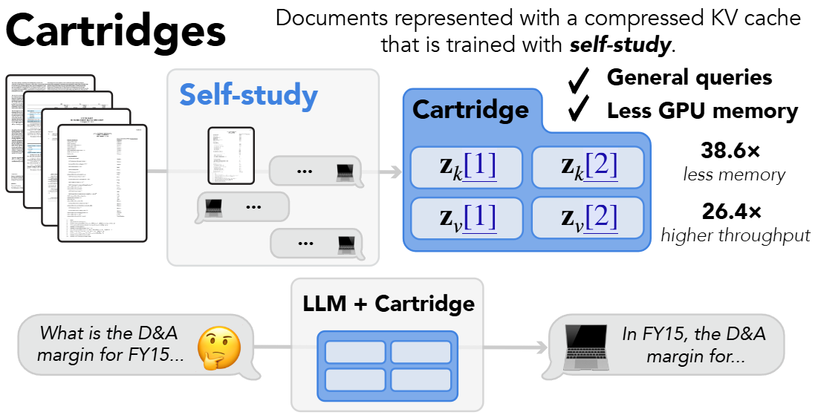
Motivation
Notes:
That’s cartridges. We can train a cartridge that represents the compressed KV cache of any given documents. The size of the cartridges can be a hyperparameter, so the memory consumption can be estimated and practically, reduced.

Slide 7
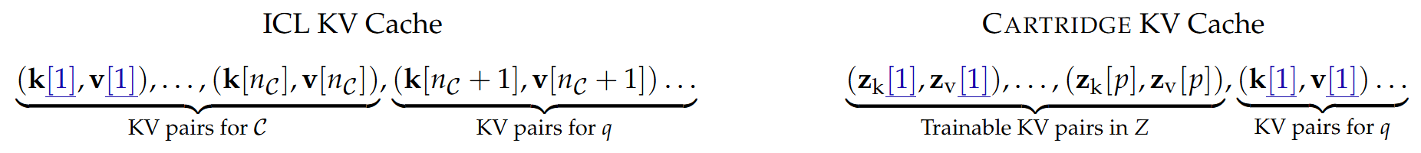
What is a Cartridge
A learned KV prefix of length p (e.g., 128–8192 tokens) attached at inference time.
No base‑model weight updates; just load/unload per corpus.
A composable module; concatenate multiple cartridges (e.g., Policy ⊕ API Docs ⊕ Codebase) for cross‑source reasoning.
Analogy: Like prefix‑tuning, but trained to imitate ICL on that corpus.
Notes:
What is a cartridge then? It’s a learned KV prefix of length p attached at inference time. While cartridge requires training separately, we do not need to change the base LLM’s weight. To serve for requests, we just load the LLM and the cartridge for the corpus of interest.
Another good thing about cartridge is that it’s composable module. The purpose of cartridges is to replace ICL but also mimicking ICL’s behavior. I would personally throw a paper, some code, and some documentation into an LLM, so it will reason based on different source of knowledge. Cartridges can do something similar, by concatenating multiple cartridges, LLMs can still do cross-source reasoning without sacrificing throughput or memory usage.
A quick analogy would be prefix-tuning, but they are trained to imitate the ICL on a certain corpus.

Slide 8
Self-study Training
Synthesize dialogs about the corpus: For each chunk 𝑐̃, auto‑generate Q↔A / instruction traces.
Teacher = base LLM with 𝑐̃ in context; Student = same LLM + trainable cartridge 𝑍 without 𝑐̃.
Objective: minimize step‑wise KL(𝑝_𝑡 || 𝑝_𝑠) over next‑token distributions.
Intuition: Student learns to act as if the corpus were present.
Notes:
So how we train? A quick intuition is self-study. We want cartridges to mimic ICL, then we just train them using the behavior of ICL as the target as if they were present.
The authors first construct a dataset of synthesized dialogs about a given corpus. For each text chunk c, they prompt LLMs to generate a QA pair/or traces.
Then they instantiate two copies of an LLM. One is the teacher model with access to the text chunk c in context, the other one is the student model with a trainable cartridge Z but not text chunk c.
They use KL divergence over next-token distributions are the loss function.

Slide 9
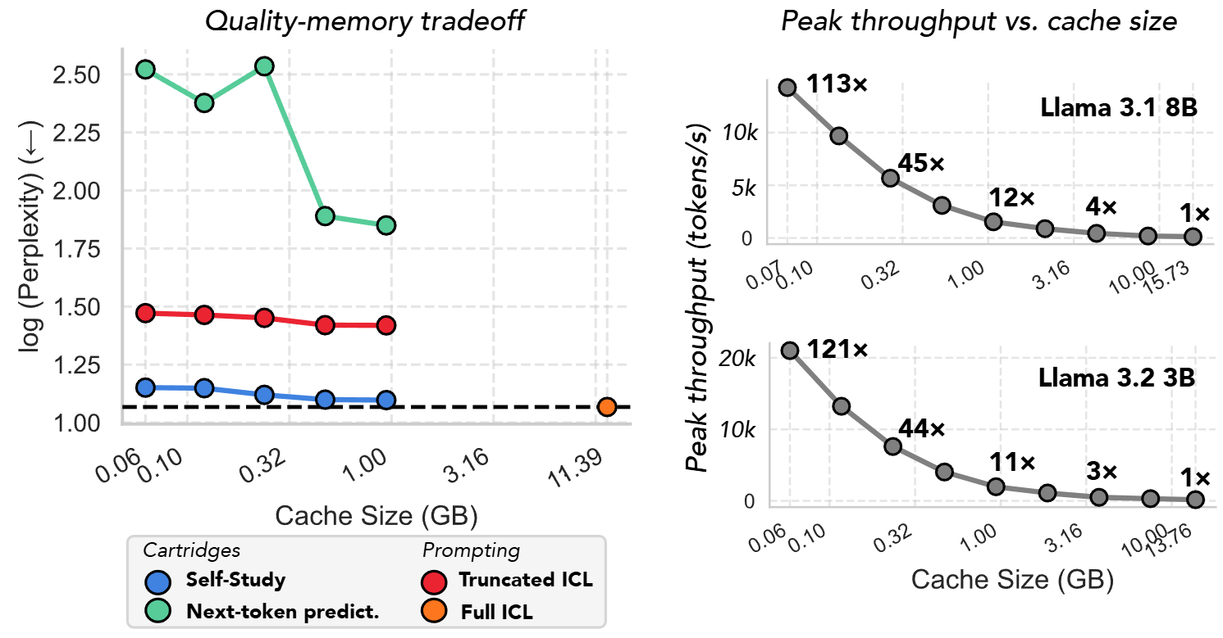
Performance: throughput and cache size
↓38.6x memory consumption and ↑26.4x peak throughput across different tasks
Notes:
Here are some results. On the left, y-axis is the log of perplexity versus memory usage. On the right is the throughput vs memory usage.
The full in context-learning baseline is at the lower right in orange. The blue line represents the Cartridges trained with self-study. We can see that cartridges achieve comparable performance using 0.5 gigs of cache, while ICL takes 12 gigs.
The red dots are another baseline, by truncating the context length and send only the first p tokens into the LLM. Using the same amount of vram, truncated ICL couldn’t match the performance of cartridges.
On the right we can see the throughput increase. At the cache size of 1 gig, we already see a throughput increase by 11 times on both 3B and 8B models. You might ask for results for larger models, but unfortunately that’s all for their experiments. Didin’t want to be a malicious reviewer, but in their introduction their story was referencing the 70B llama model, so it would nice if they could scale up the experiment after publication.

Slide 10
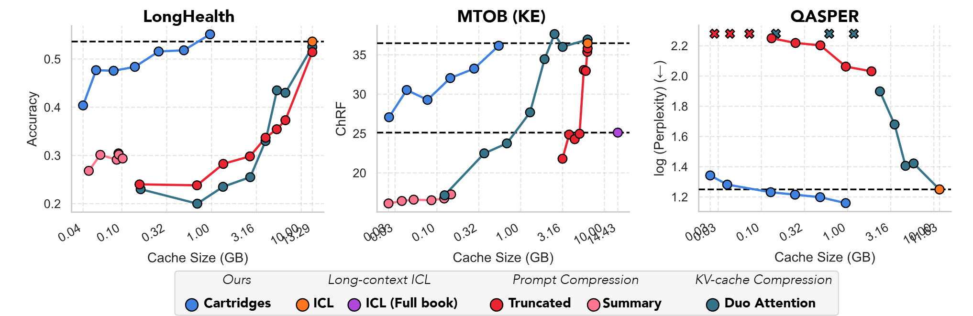
Performance: Cartridges vs baselines
Cartridges matches ICL quality with lower memory costs.
Notes:
Here are some finegrained comparison with different setups on various datasets. Results close to upper left are better for the first two. Lower left for the last one. The overall theme here is, again, cartridges matches ICL quality with lower memory costs.

Slide 11
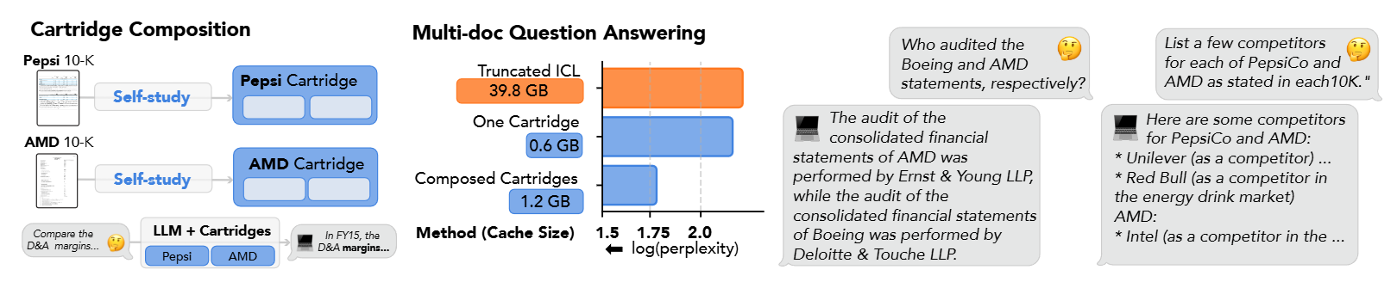
Surprising notes
Context stretch: Effective context extended (e.g., 128k → ~484k on MTOB)
Composition: Multiple cartridges combine without re‑training.
Notes:
Besides better performance compared to ICL, the authors also found cartridges magically extended the effective context length. For example, the LLama model they used has a context length of 128k, but the corpus MTOB has about 484k tokens. From the previous slide, cartridges are still capable of handling them without noticeable performance degradation.
Another findings is that multiple cartridges can be combined together without re-training during inference time. Not only they are able to maintain optimal performance, the authors actually observed even lower perplexity using a combination of cartridges train on separate corpus.

Slide 12
Cartridges vs RAG? LoRA?
RAG
Good for flexible and live updates, but retrieval and long prompts are still costly.
-> Cartridges are optimized on stable, repeatedly‑queried corpora.
Much more expressive for training, but also to serve on infrastructures.
LoRA
-> Cartridges are prefix‑only; also outperperforms LoRA.
Notes:
That’s pretty much for the performance, and we have some short discussions.
The first is, how does it compare with RAG and LoRA. Well, RAG is known for its flexibility, but the bottleneck becomes retrieval. LoRA is much more expensive than Cartridges both in terms of training and deployment. In these cases, Cartridges are optimized on stable and repeatedly queried corpora, prefix-only, and outperforming LoRA on several benchmarks.

Slide 13
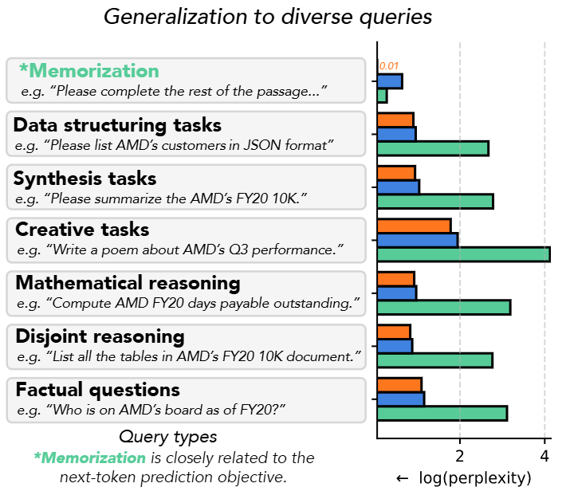
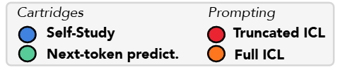
Other discussions
A Cartridge can be served efficiently with minimal changes to existing LLM inference servers (e.g. SGLang)
Limitations:
Upfront compute: Strong performance but training must be amortized
Coverage: training rely on synthetic dialogs; bad dialogs cause blind spots
Timeliness: Corpus changes require re-training or incremental fine‑tuning
Notes:
Since we mentioned deployment, on the technical side, these kind of modules can be easily integrated in latest LLM inference frameworks with minimal modification. The authors used SGLang for experiments, but also mentioned the compatibility with other softwares like vllm. But that’s on the research side. What will happen if this were to be massively deployed, say by OpenAI?
Also, to their credits, the authors carefully reflected on some real limitations of this work. Despite the strong performance of cartridges, the extra training efforts must be amortized by sufficiently many requests. Is it practical? At least for now?
Currently, the training is based on synthetic dialogs, and if the dialogs are not comprehensive enough to capture the original corpus, there will be blind spots. What are some ways to mitigate this? More synthetic data?
And possibly the most challenging one: corpus, like code base changes all the time. These cartridges require constant updates/re-training. Does this make Cartridges less useful practically?
I'll leave these for discussion.

Slide 14
Takeaways
Cartridges = compact, reusable memory of a corpus with ICL‑like behavior.
Use Self‑study (synthetic dialogs + context distillation) for training.
For repeated queries, strong performance in terms of larger throughput and reduced memory
Notes:
So some takeaways.
The authors proposed cartridges, which are some compact and reusable memory modules of a corpus to mimic the ICL behavior.
The training uses a typical self-study on synthetic dialogs.
Empirical results are very strong compared to baselines both in terms of larger throughput and reduced memory usage.
And that concludes my presentations. Thanks everyone, and here’s Yingfei for the second paper.

Slide 15

BumbleBee: Dynamic KV-Cache Streaming Submodular Summarization for Infinite-Context Transformers
Lilly Kumari, Shengjie Wang, Tianyi Zhou, Nikhil Sarda, Anthony Rowe, Jeff Bilmes

Slide 16
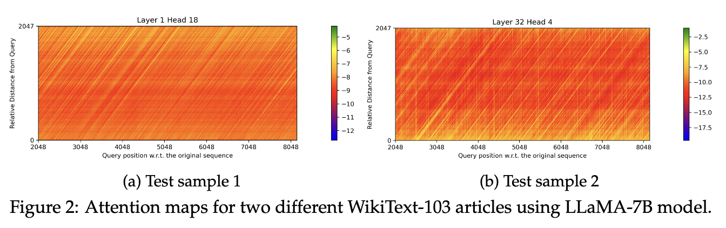
Motivation
strongly attends to a small subset of tokens
Notes:
Is it possible to maintain the LLM’s performance on downstream tasks without storing every observed token representation in the KV cache?

Slide 17
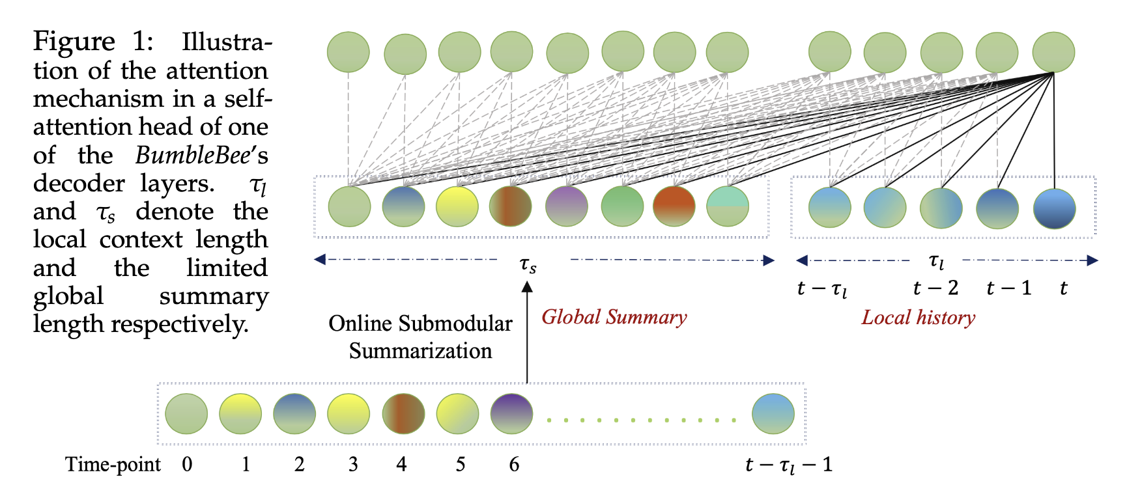
Core Idea
Existing methods use modular scores, where each KV state is evaluated independently
Frame the KV cache selection as subset selection problem with submodular objective function
Notes:
Existing methods such as attention sinks or heuristic ranking (H²) evaluate each token independently,
but that ignores inter-token relationships — for example, two tokens might both be important but highly similar, meaning keeping both is wasteful.
BumbleBee therefore frames the KV eviction process as subset selection: among all past tokens, select a subset S that best represents the entire context while satisfying a memory budget. And this selection is guided by a submodular objective function, which naturally balances importance and diversity through the property of diminishing returns.

Slide 18
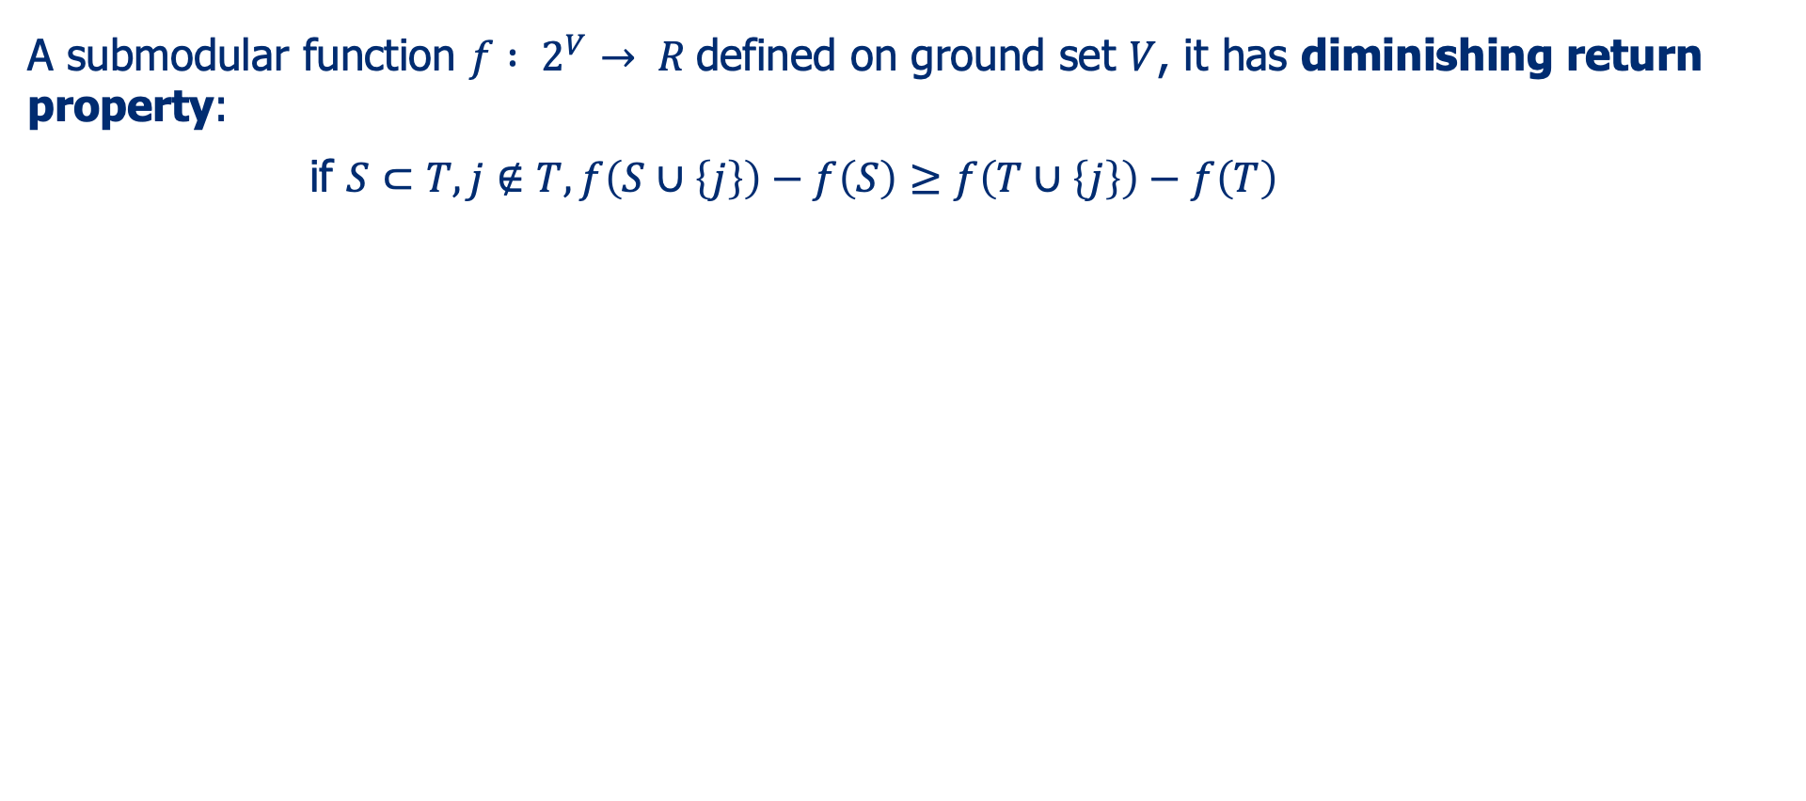
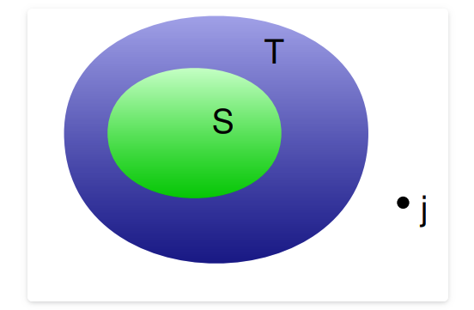
Submodular
Greedy algorithm for submodular maximizationa has theoretical (1 – 1/e) guarantee from the optimal solution
Notes:
So, why use submodularity?
Submodular functions have a key property called diminishing returns —the more items you already have, the less additional gain you get from adding another similar one.
This property perfectly matches what we want in cache selection: if we already have several tokens describing the same idea, adding one more doesn’t provide much extra information.
Therefore, submodularity encourages diversity —the algorithm prefers to keep representative but non-redundant tokens. Moreover, submodular optimization admits efficient greedy algorithms with a proven (1 – 1/e) approximation guarantee. That means even though finding the exact optimal subset is NP-hard, we can find a near-optimal one with linear-time greedy selection. This theoretical guarantee is what sets BumbleBee apart from heuristic approaches.

Slide 19
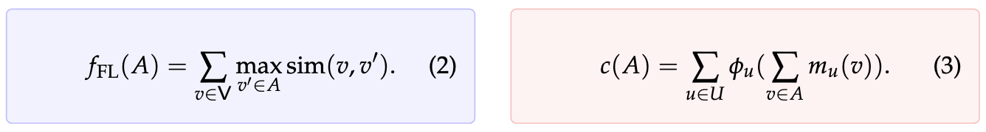
Submodularity
How to select a subset?
Diversity
Importance
facility location (FL) function
how well a subset can represent the whole set
feature-based function
how much total importance is captured
Notes:
The paper explores two well-known types of submodular functions.
1. The Facility Location Function:
It measures how well the chosen subset represents the full set.
For every token in the original sequence, we look at its maximum similarity to any selected token.
If that similarity is high, it means our subset “covers” the token’s semantics.
2. The Feature-Based Function:
This function sums the importance of each feature dimension,
weighted by how much that feature appears in the selected tokens.
A concave transformation on the feature sum ensures diminishing returns.

Slide 20
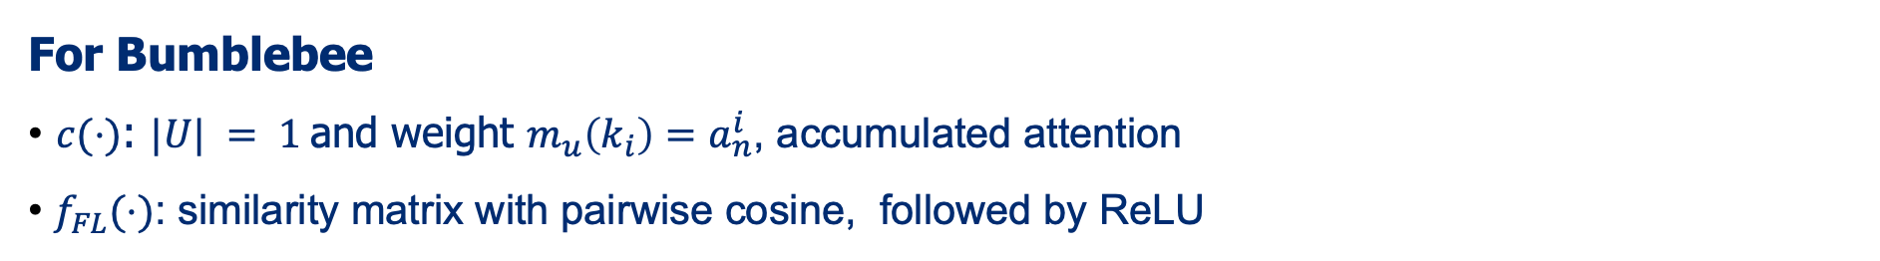
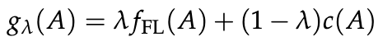
Submodularity
Mixture function: trade-off
normalized with
Notes:
Now let’s see how BumbleBee actually implements these two submodular functions in practice.
For the feature-based function, the ground set ∣U∣ is one — that means we consider a single global feature dimension,
and the weight mu(ki)m_u(k_i)mu(ki) for each token is set to its accumulated attention score. a concave function to transform modular attention scores into a strictly submodular objective
For the facility-location term, BumbleBee computes a similarity matrix between tokens using pairwise cosine similarity, followed by a ReLU activation to remove negative correlations
Then both functions are normalized so that their values range beten 0 and 1
Finally, BumbleBee defines a mixture function that combines the two:
The trade-off parameter λ controls the balance

Slide 21
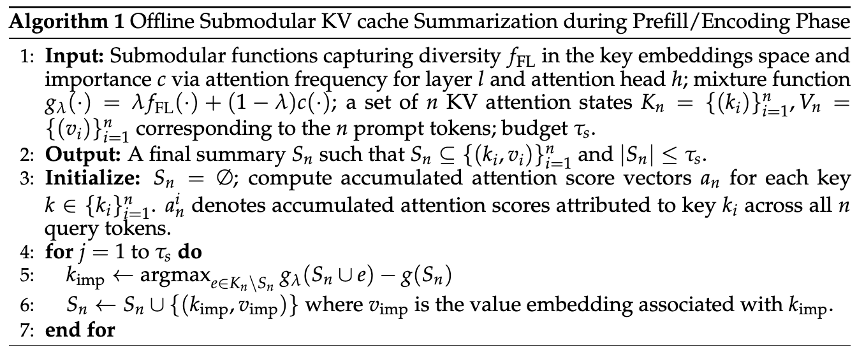
Offline algorithm
Notes:
BumbleBee proposes two algorithms for different settings.Offline algorithm:In each step, it finds the one key, k_imp, from all the keys not in our set, that gives the maximum marginal gain to our submodular function g.

Slide 22
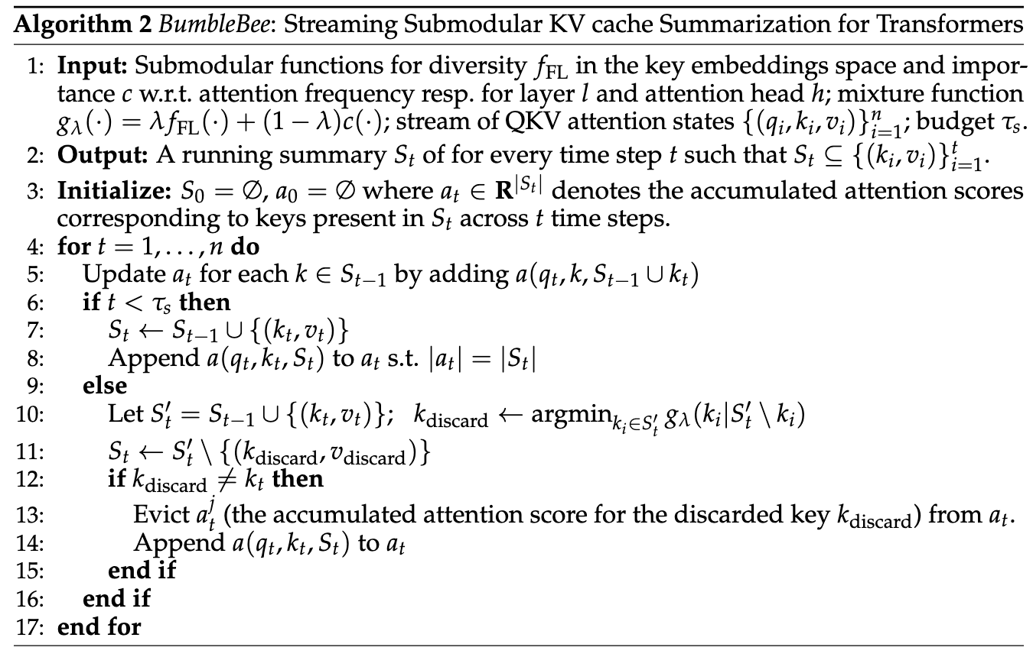
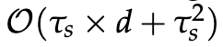
Online algorithm
fill until budget, else greedy choose worst one to evict
for each new token compute costs
Notes:
Online algorithm:
Line 10: It first temporarily adds the new token k_t, creating an overloaded set S'_t of size τ_s + 1.
Line 10 (The Key Step): Then, it iterates through every token in this overloaded set and calculates: 'If I remove this token, how much will my total score g_λ decrease?'
It finds the one token, k_discard, that causes the minimum loss to the total score. This is essentially the 'worst' or 'most redundant' token in the set.
constructing the pairwise similarity matrix for fFL has a time complexity of O(τs2 × d). Identifying the item with the least conditional gain (Line 11 of Alg. 2) requires O(τs2). However, if we cache the similarity matrix, we only need to compute the similarity of the incoming item to the others in the summary, resulting in an overall complexity of O(τs × d + τs2) for each new token.

Slide 23
Experiments
Datasets from benchmark: lm-eval-harness, HELM, LongBench
Models: LLaMA 7B and 13B, LLaMA2 7B and 13B, Llama-2-Chat 7B and LongChat-32k 7B
Baselines: All, Local, Random+Local, Attention sinks+Local, H2+local
Submarine software system for submodular computation
Notes:
The authors evaluated BumbleBee on multiple benchmarks:lm-eval-harness, HELM, and LongBench,
which test both standard and long-context reasoning capabilities.They used models including LLaMA 7B, LLaMA 13B, LLaMA-2 7B & 13B,as well as LLaMA-2-Chat 7B and LongChat-32k 7B.
The baselines include:
keeping all tokens (upper bound),
local window retention,
random + local mixture,
attention sinks + local, and
H² + local, a heuristic importance-based approach.
For computation, they use Submarine, a specialized software system that efficiently computes submodular gains in parallel

Slide 24
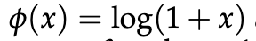
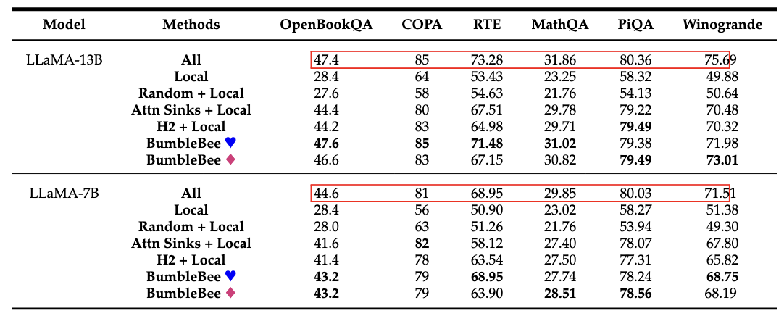
Experiments
llm-eval-harness benchmark, 0.1x the input length as budget
(♥) log-based
(♦) power-based
Notes:
On lm-eval-harness, with only 0.1× of the input length kept as cache budget,BumbleBee achieves almost the same accuracy as the full-cache baseline

Slide 25
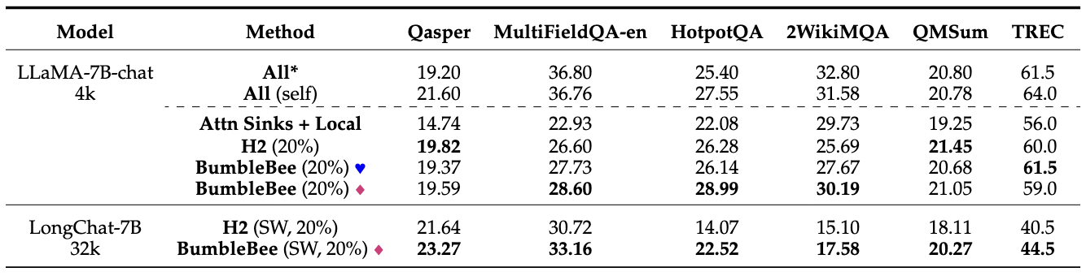
Experiments
LongBench benchmark, λ=0.3
Notes:
On LongBench, a long-context reasoning benchmark, BumbleBee also performs better than all other compression or eviction strategies.
Sliding Window (SW) strategy to process smaller chunks/segments of longer contexts, aggregate their KV embeddings, and the attention scores accumulated for keys in different chunks.

Slide 26
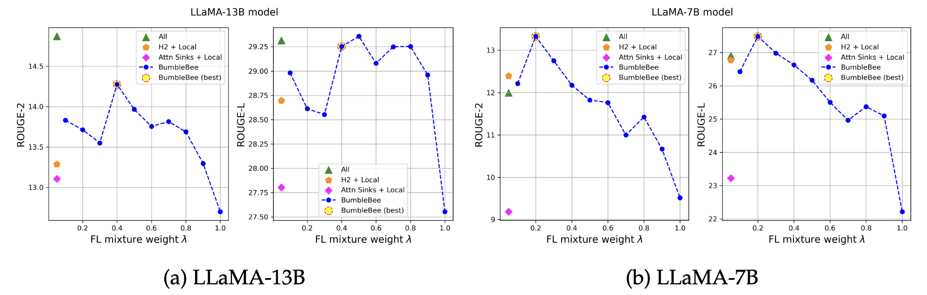
Experiments
XSUM dataset, few-shot summarization task
λ=0.2 still better than H2+local (which equals to λ=0 and φ is identity function)
Notes:
λ ∈ [0.4, 0.8] performs comparably showing that a representative subset of the KV cache is preferred for the downstream task. In LLaMA7B, we see that for λ > 0.2, the performance starts to drop as we increase the mixture weight λ corresponding to the Facility location function f (·). However, the first submodular component with its relative weight of 0.2 still outperforms the H2 + Local method showing that both representativeness and relevance of the selected cache subset are desirable to maintain a performance comparable to the entire cache setting.

Slide 27
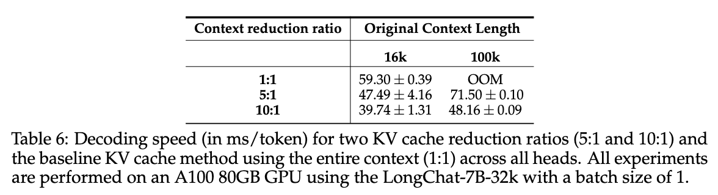
Experiments
Notes:
Compares the decoding speeds (in ms/token) for two different context reduction ratios, demonstrating faster decoding speed as the context reduction ratio becomes higher

Slide 28
Takeaways
introduce diversity into selection aside from only importance(H2O)
reframe eviction as subset selection problem, and submodularity guarantees that a simple Greedy Algorithm achieves a near-optimal solution
Discussion:
rely on submodular optimization tool(not open-source)
redundancy/diversity matters
R-KV: heuristic ranking Z = λ⋅Imp - (1-λ)⋅Redu
OmniKV: inter-layer redundancy
Notes:
To summarize the key takeaways:
BumbleBee reframes KV cache eviction as a submodular subset selection problem. It ensures that selected tokens are both important and diverse. The greedy optimization is theoretically near-optimal with a (1 – 1/e) bound.
The method is applicable in both offline and streaming scenarios, enabling infinite-context transformers.

Slide 29
Thank You!
jhu.edu
Notes:
Tip: There’s no need to include WWW or HTTPS in front of your URL.

